Slide 1


Sentiment Analysis on Textual Data
Using NLP Techniques for Sentiment Analysis. This presentation will cover the process, from data to insights.
by Sangram Sonawane

Slide 2

Introduction to Sentiment Analysis
Sentiment analysis determines the emotional tone in text. It classifies sentiment as positive, negative, or neutral.
This method helps monitor social media and customer reviews. We aim to build a model to categorize text sentiment using NLP.
1
What is Sentiment Analysis?
2
Objective
Determines sentiment in text.
Classify text into sentiment categories.

Slide 3
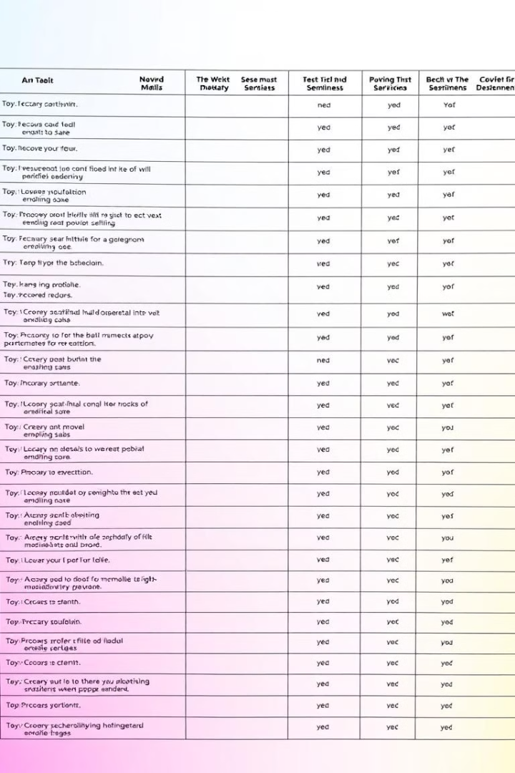


Dataset Overview
Our data comes from text reviews. The key attributes are review text and sentiment label.
Preprocessing involves cleaning, noise removal, and tokenization. Stopword removal and lemmatization are also crucial steps.
Data Source
Key Attributes
Text review dataset.
Review text, sentiment label.

Slide 4

Data Preprocessing Steps
We convert text to lowercase. Then remove special characters and URLs.
Tokenization breaks text into words. Stopword removal eliminates common words. Lemmatization reduces words to their base form.
Lowercase
Remove Noise
Convert text to lowercase.
Remove special characters & URLs.
Tokenize
Lemmatize
Break text into words.
Reduce words to base form.

Slide 5

Code Implementation - Data Loading
First, upload the data file. Next, load the CSV using pandas.
The \`df.head()\` function shows the first few rows.
from google.colab import files uploaded = files.upload() import pandas as pd df = pd.read_csv("your_file.csv") df.head()

Slide 6
Code Implementation - Preprocessing
This code cleans the review text. It removes URLs and special characters.
It also tokenizes, removes stop words, and lemmatizes. The cleaned reviews are stored in a new column.
import nltk import re from nltk.tokenize import word_tokenize from nltk.corpus import stopwords from nltk.stem import WordNetLemmatizer nltk.download('punkt') nltk.download('stopwords') nltk.download('wordnet') lemmatizer = WordNetLemmatizer() stop_words = set(stopwords.words('english')) def clean_text(text): text = text.lower() text = re.sub(r"http\\S+|www\\S+|https\\S+", '', text) text = re.sub(r'[^A-Za-z ]+', '', text) tokens = word_tokenize(text) words = [lemmatizer.lemmatize(word) for word in tokens if word not in stop_words] return " ".join(words) df['cleaned_review'] = df['review'].apply(clean_text) df.head()

Slide 7

Sentiment Classification Model
We use machine learning for classification. Naive Bayes or Logistic Regression.
Text data is converted to numerical format. TF-IDF is a common method. Model performance is then evaluated.
1
Numerical Format
Convert text to numbers.
2
Train Model
Train sentiment classifier.
3
Evaluate
Assess model performance.

Slide 8
Code Implementation - Model Training
This code trains a Naive Bayes model. It uses TF-IDF to vectorize the text data.
The model is trained on the training set. Accuracy is calculated on the test set.
from sklearn.feature_extraction.text import TfidfVectorizer from sklearn.model_selection import train_test_split from sklearn.naive_bayes import MultinomialNB from sklearn.metrics import accuracy_score vectorizer = TfidfVectorizer() X = vectorizer.fit_transform(df['cleaned_review']) y = df['sentiment'] X_train, X_test, y_train, y_test = train_test_split(X, y, test_size=0.2, random_state=42) model = MultinomialNB() model.fit(X_train, y_train) y_pred = model.predict(X_test) accuracy = accuracy_score(y_test, y_pred) print(f'Model Accuracy: {accuracy * 100:.2f}%')

Slide 9
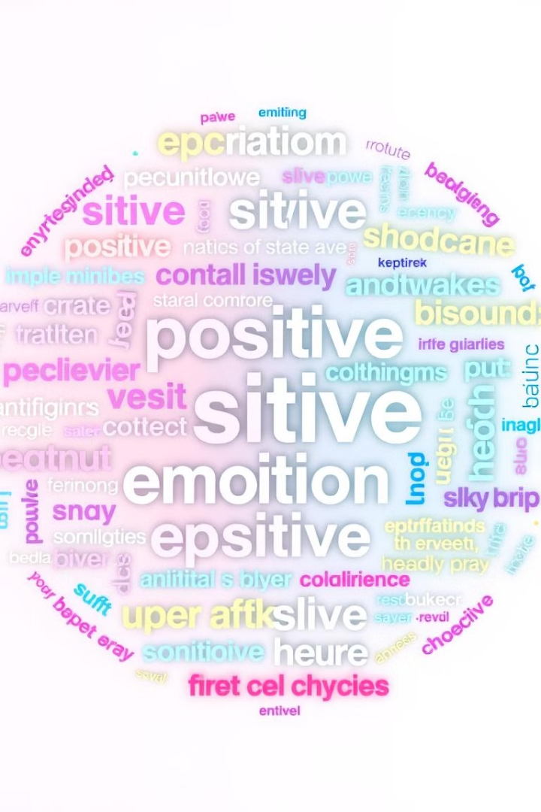



Results and Insights
Model accuracy is calculated. We observe key words for classification.
Common misclassifications are noted. Visualization techniques like word clouds are used.
Observations
Words aiding classification.
Misclassifications
Common errors identified.
Visualization
Word clouds and charts.

Slide 10


Conclusion and Future Scope
Sentiment analysis helps understand opinions. Preprocessing enhances model accuracy.
Future work includes deep learning models. Larger datasets improve generalization.
1
Key Takeaways
Future Work
2

